Slide 1
Unit 3 Assignment 2
Create Test and review Your Portfolio
link to Portfolio

Slide 2
Target audience
The target audience for my portfolio are future employees, universities or apprenticeships who are interested in my IT skills for employment or apprenticeships and knowledge, or any other skills I might be learning in future courses.

Slide 3
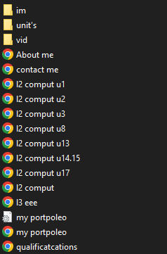
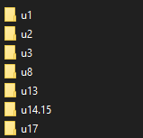
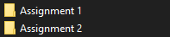
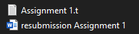
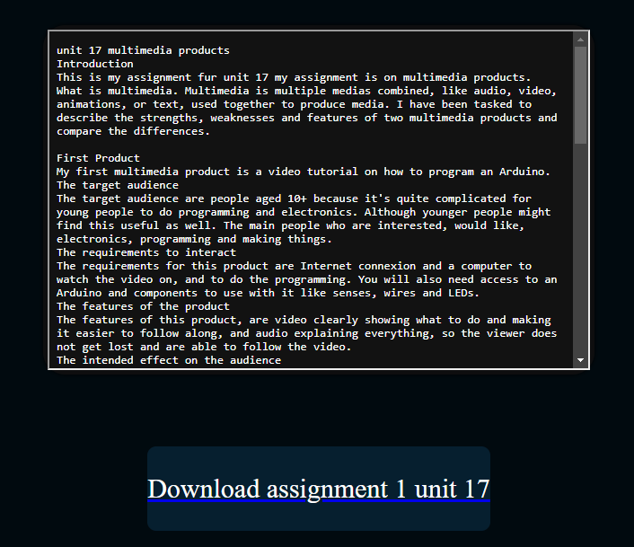
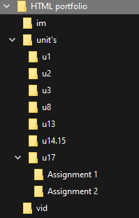
File structure
Here is my file structure, I have structured all the file and correctly labeled them so that it is easier to work on the portfolio and make changes, it also allows for other people to work on it without me having to explain what everything is.
I have a file for images, all my units and videos. inside all my units I have a folder for each unit with the content for each assignment and a text document copied from the actual assignment to display on the site so the audience can see my work.
I have added a box with a copy of the assignment in built into the website so my audience can view my work in my portfolio without having to download any files if they want.
I have added a link so they can download my assignments and view the work and see if I have the skills that they are looking for.

Slide 4
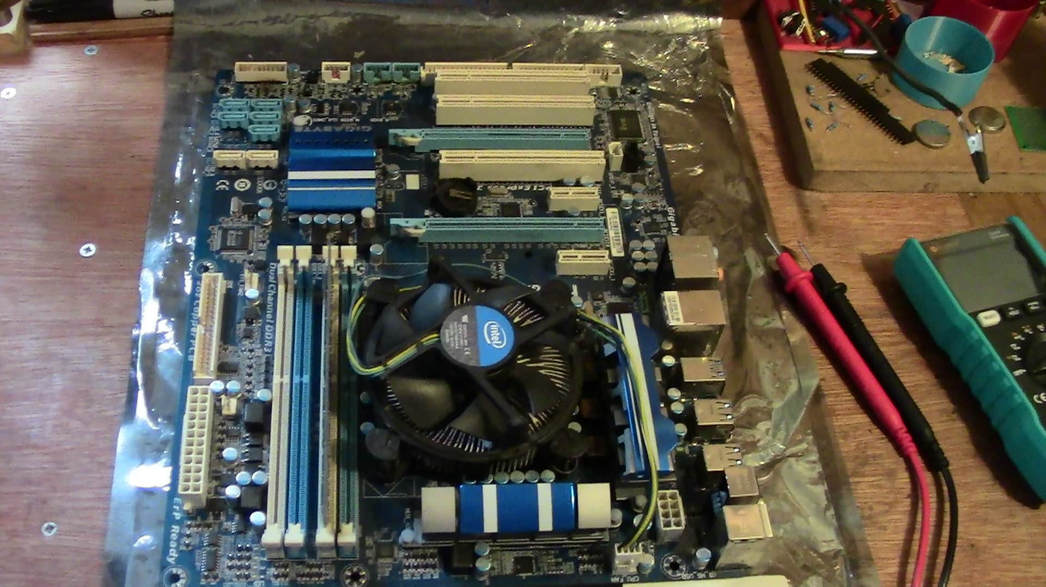
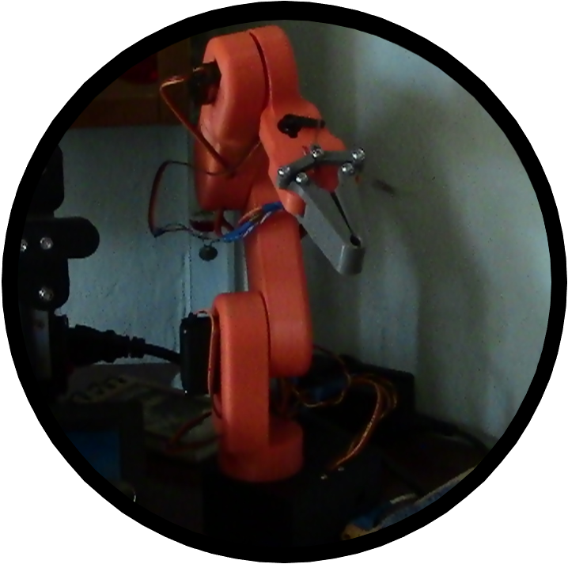
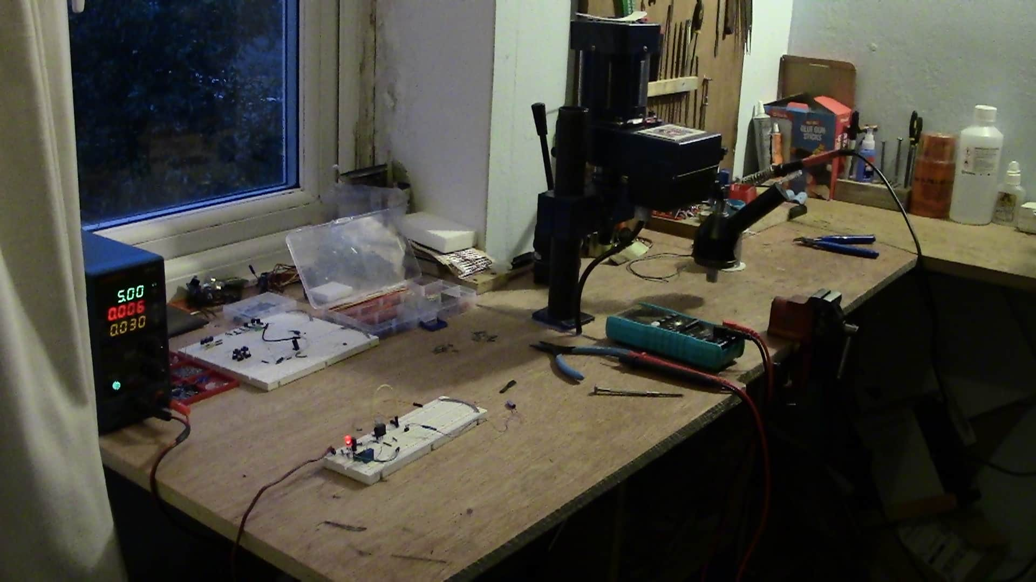
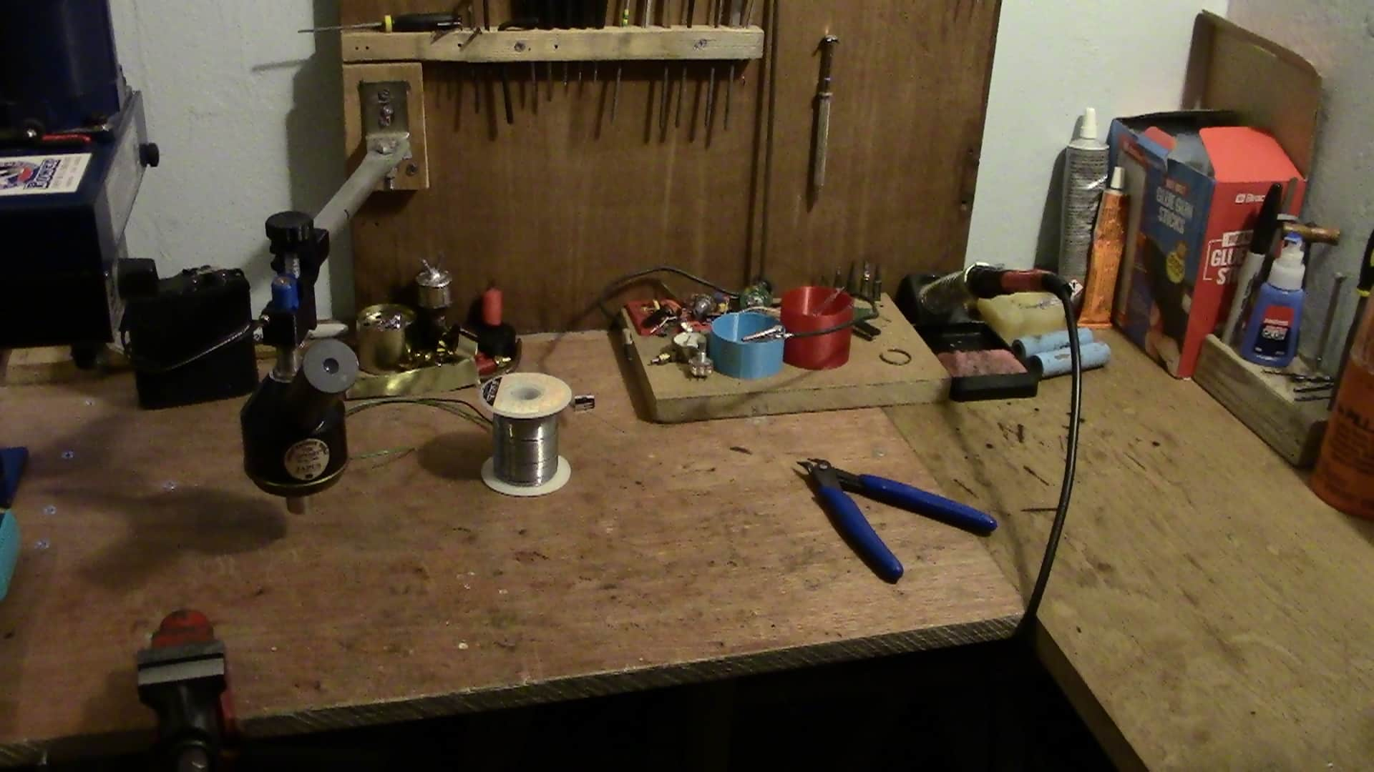
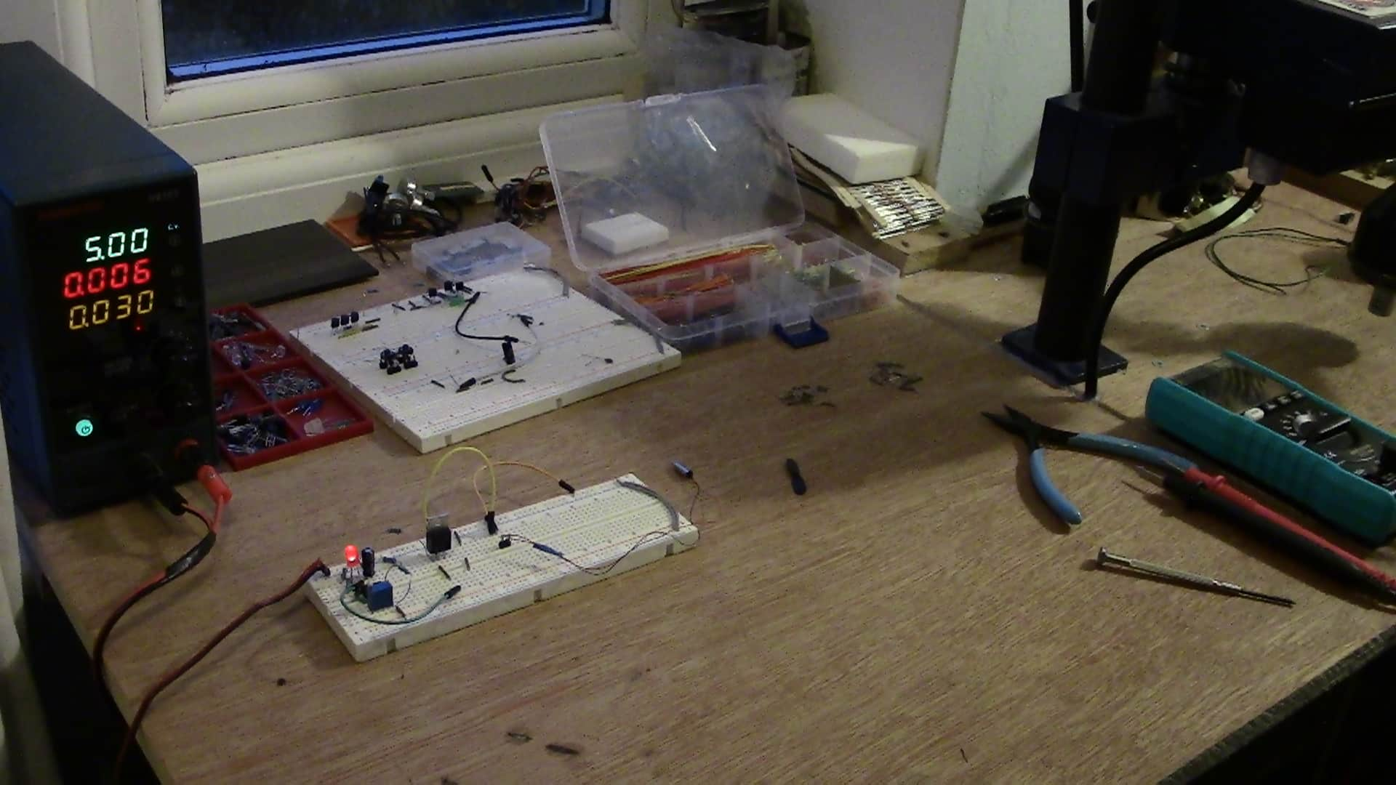
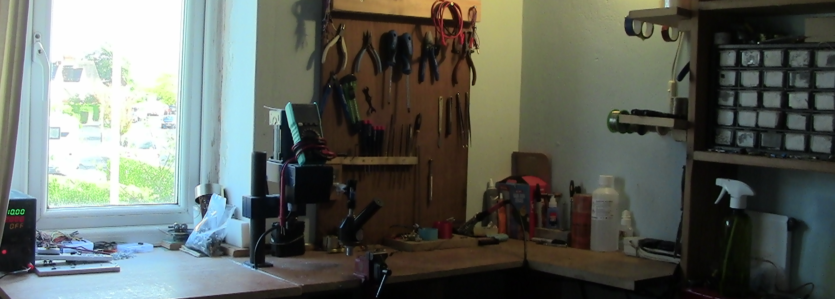
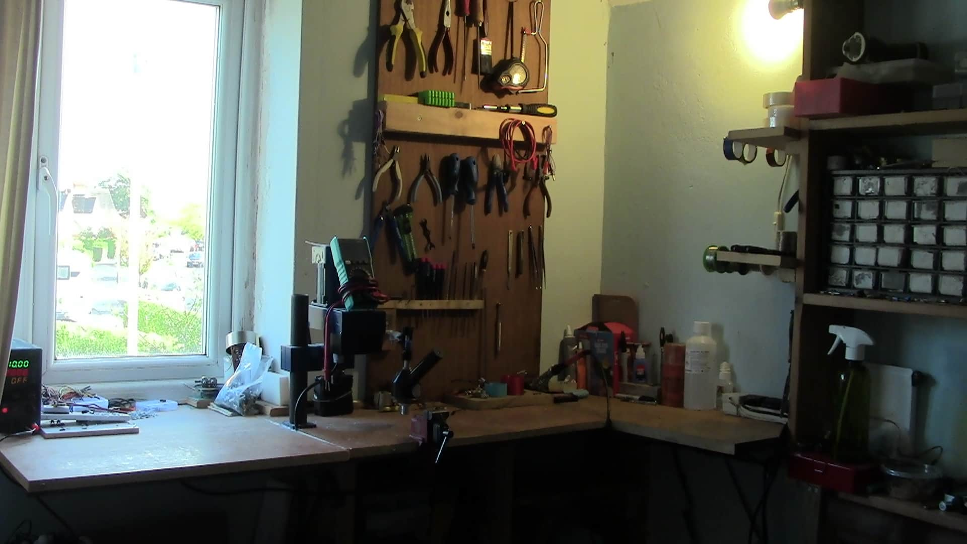
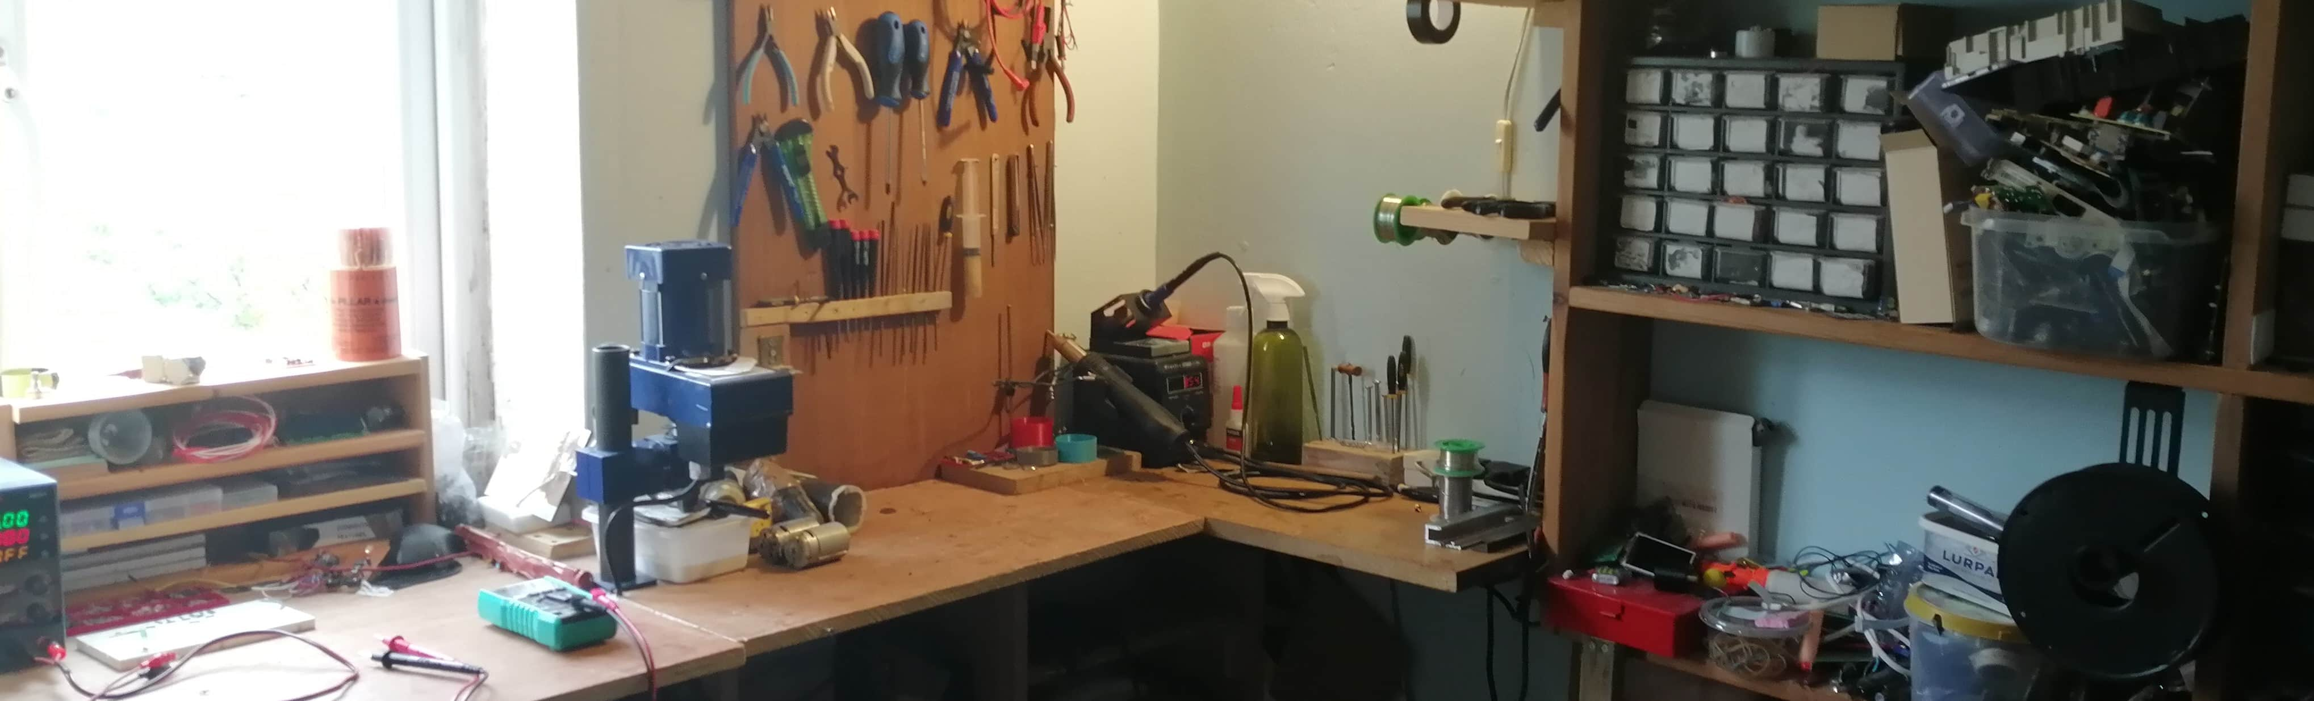
My new asset table
Date | Image/asset​ | File format​ | Where it is saved/sourced​ | URL​ | Size​ | ​ suitability
11/4/23​ | ​ | JPG | my OneDrive​ | NA | 901 KB​ | This image i it's suitable for the intended audience because it shows what I've been doing in the course, informing them of my skills and knowledge.
10/5/2023 | ​ | PNG​ | my OneDrive​ | NA | 433 KB​ | This favicon well make My Portfolio look more professional for employers or apprenticeships; this makes it suitable for the target audience because it show the relevance of My Portfolio to them straight away with this catching favicon.
9/10/22​ | ​ | JPG​ | My OneDrive​ | NA​ | 649 KB​ | This image is suitable because it Shows what I am interested in, and my skills to demonstrate my skills to the audience.
9/10/22 | ​ | JPG​ | My OneDrive​ | NA​ | 666KB​ | This image is suitable because it shows what I like doing and my interests to educate my audience on my skills and show two apprenticeships.
9/10/22 | ​ | JPG​ | My OneDrive​ | NA​ | 731KB​ | ​ this image shows my skills and interests to the audience this is necessary to show what my skills are, so they employ me.
10/5/2023 | ​ | PNG | My OneDrive​ | NA​ | 1.38MB | this image is suitable for the audience because it displays my workshop and skill to interest employers in me and my skills.
7/10/22​ | ​ | JPG​ | My OneDrive​ | NA​ | 583KB​ | ​ this image shows my unique workshop for the audience in a suitable way to attract the target audience.
10/5/2023 |  | JPG | My OneDrive | NA | 670KB | This image is suitable for displaying my workshop and skill set and this is suitable for the website because it can be used to show my unique skills and abilities.

Slide 5
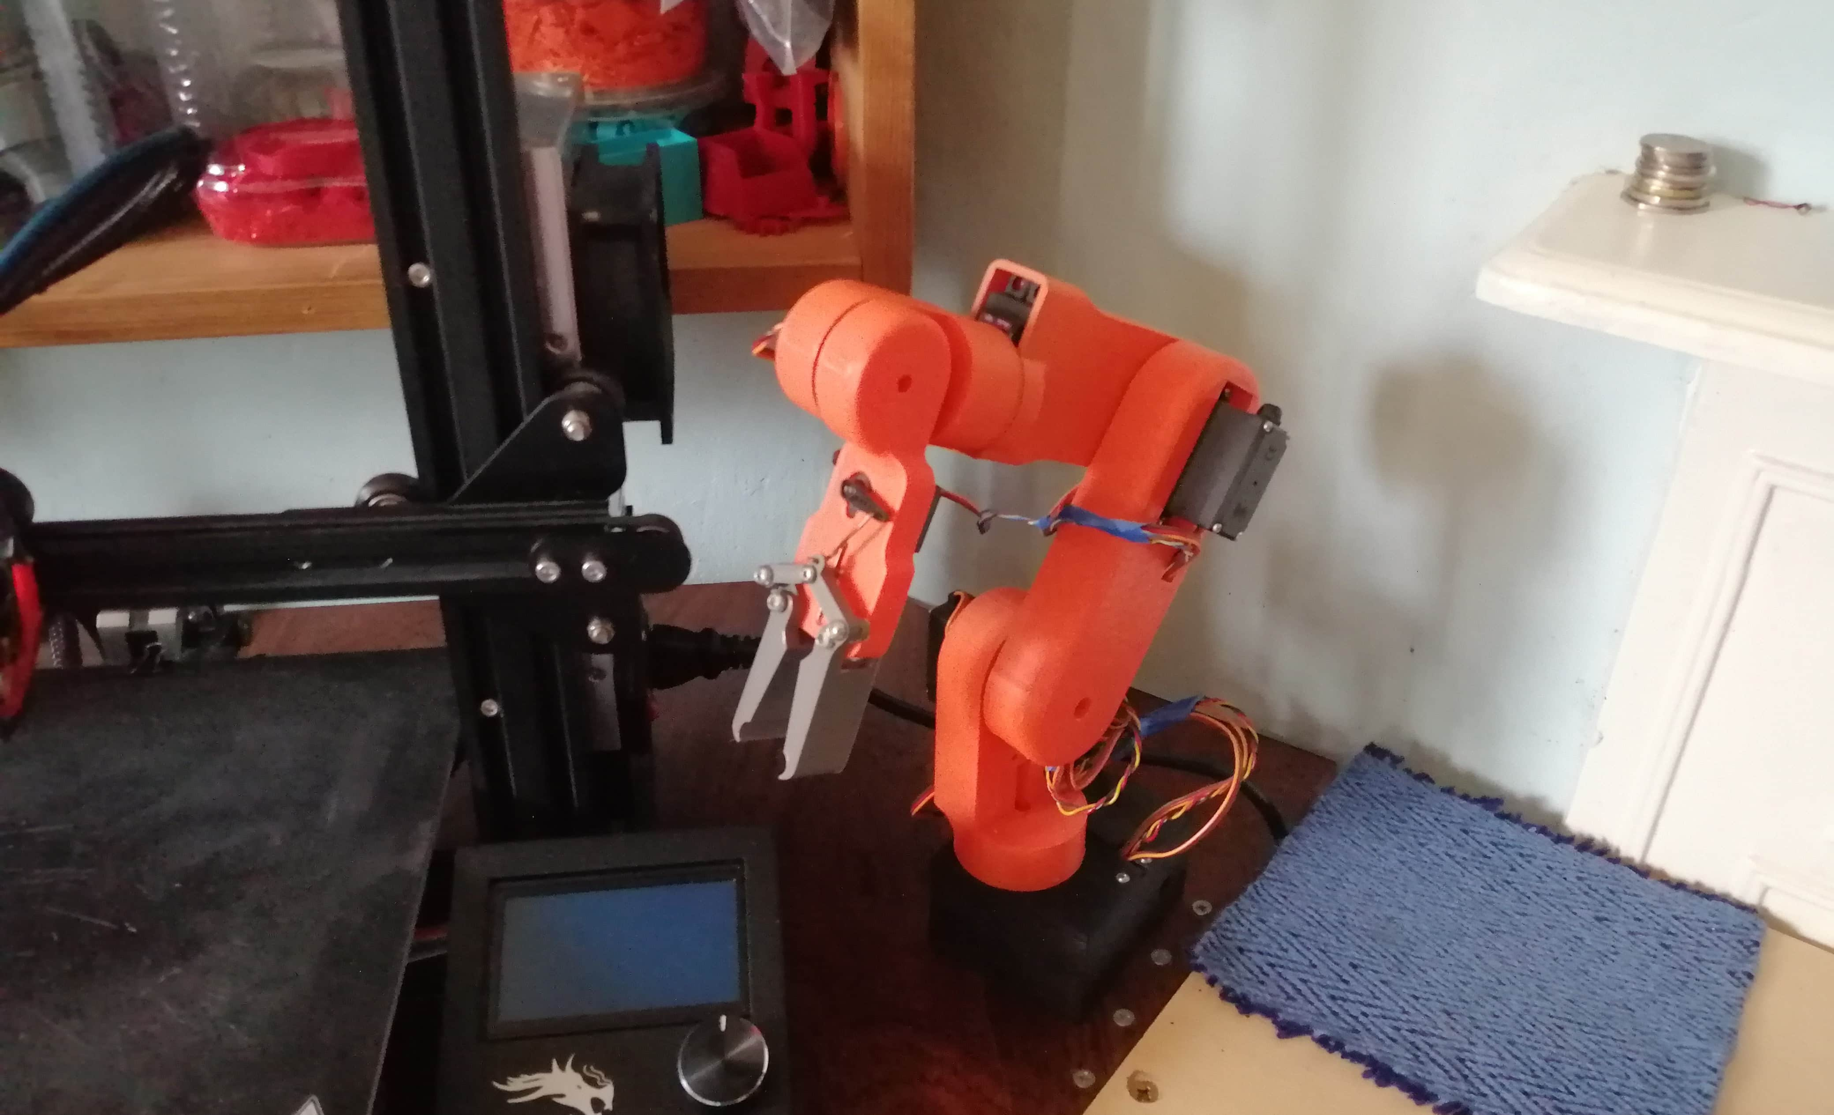
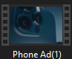
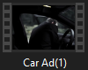
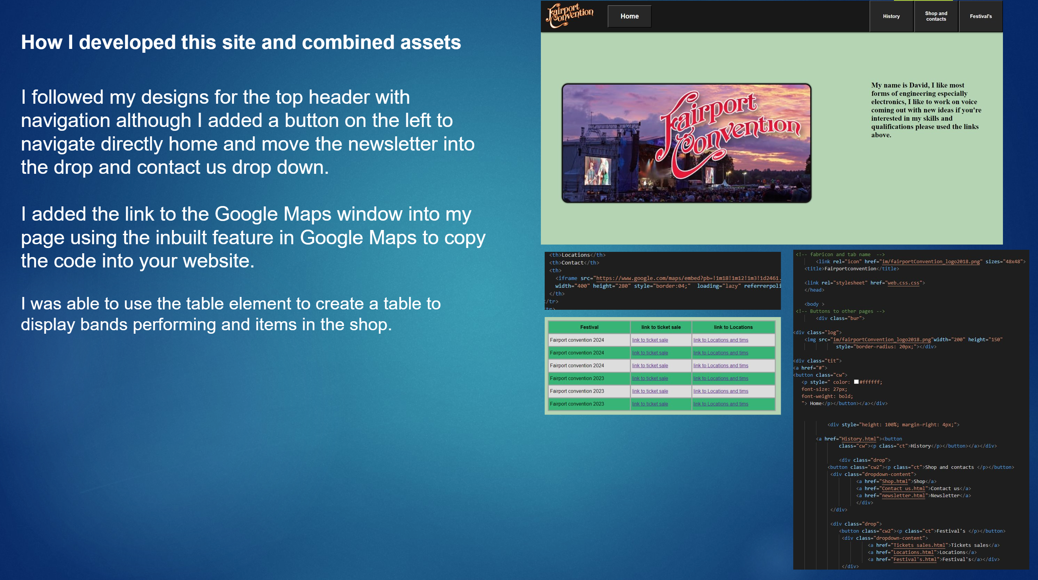
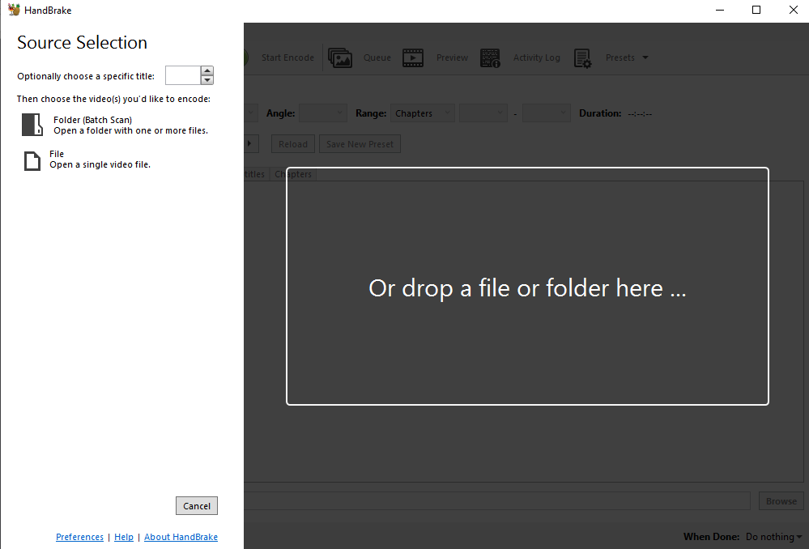
New additional asset table
Date | Image/asset​ | File format​ | saved/sourced​ | URL​ | Size​ | ​suitability
10/5/2023 | ​ | JPG | My OneDrive​ | NA | 1.45 MB​ | ​ this image is very super exposed space one of my projects which can help to educate my future employers of my skills and interests.
2022 | ​ | MP4 | My OneDrive​ | NA​ | 8.29 MB | ​ this video will help to show why were that I've done and what I've learned in my course.
2022 | ​ | JPG​ | My OneDrive​ | NA​ | 4.82 MB | ​this video will help to show why were that I've done and what I've learned in my course.
2023 |  | JPG | My OneDrive | NA |  | This is suitable for the intended purpose of my Portfolio as it displays my work and skills to the audience future employers or apprenticeships.
File format and size for uploading to Internet
I made sure all the assets were suitable for the web, some of the videos were too large to be uploaded so I used this software Hand Brake reduce the size of the files so I could upload them to the web.
I had to resize some images so there would be suitable for the area of the portfolio that have been used like in the top header.

Slide 6
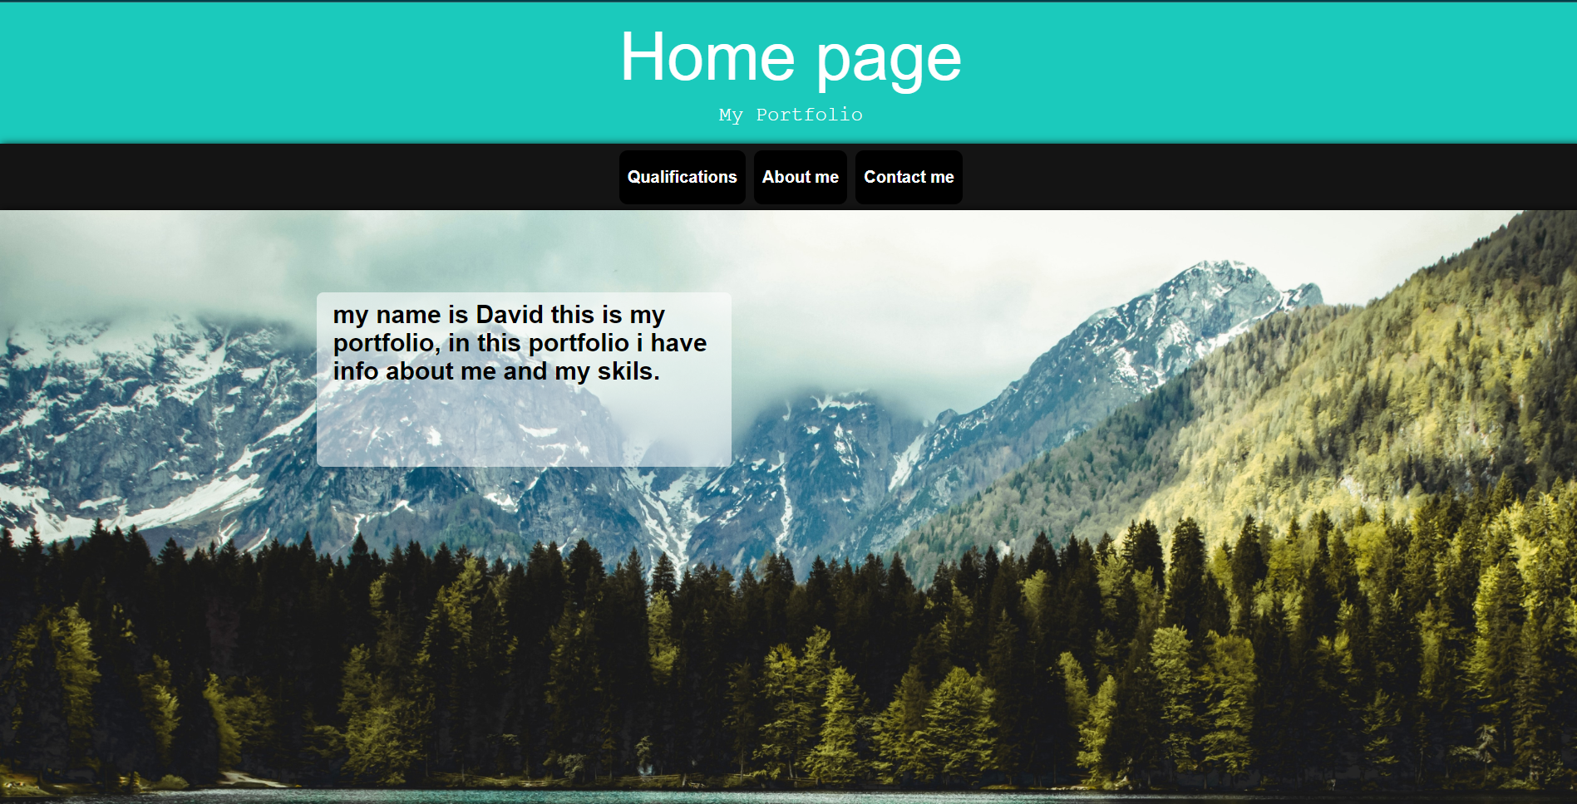
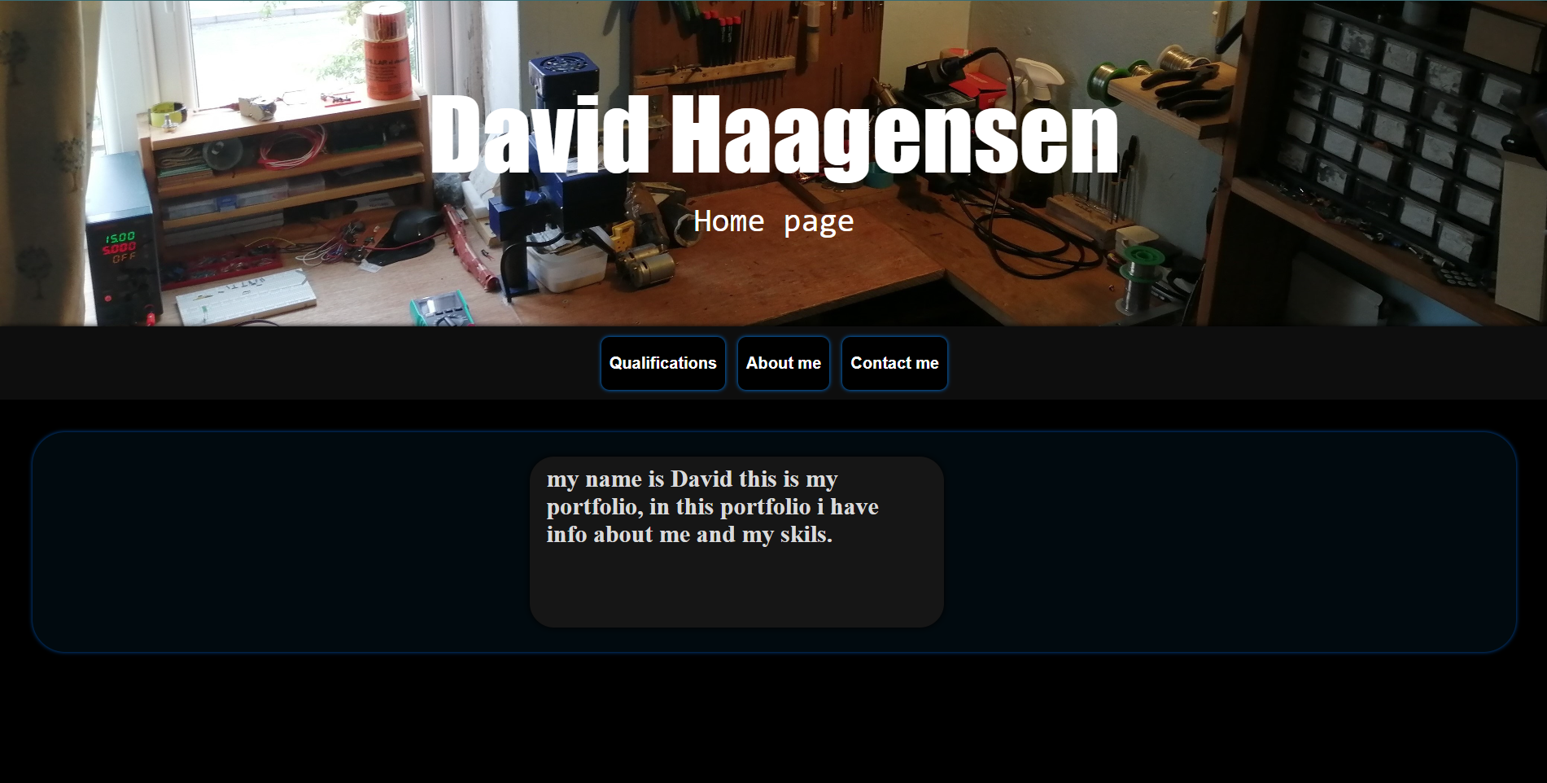
Extra content and design changes
I decided to add an image to create a more interesting website with a more professional look, but I decided to move the image up to the top header and make it a more relevant image to display my unique interests and skills.
Although this image arguably makes it harder to read the text it looks more professional and it's more you unique to my interests and skills, and I changed the font time to a larger size and thicker type, so it is easier to see.
I also changed the text boxes to a dark Gray color and put them inside a Navy-blue box to add a bit of color into the page, a more professional look and made it more interesting.

Slide 7
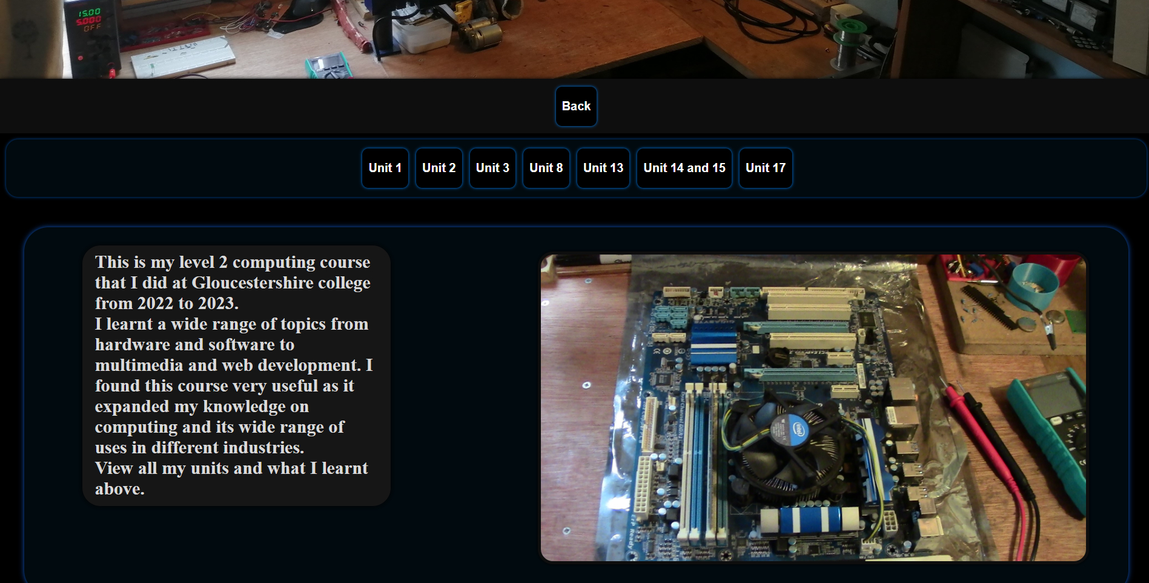
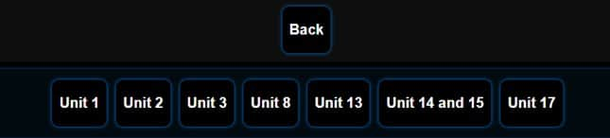
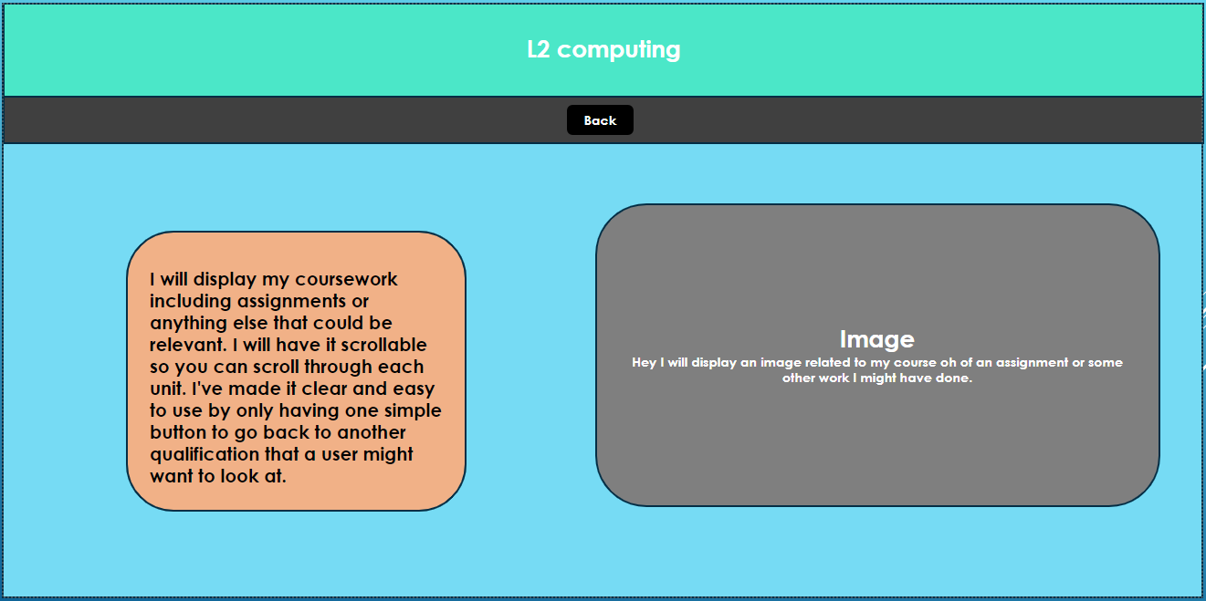
Extra content and design changes
I added separate buttons to a separate page for each unit of my course, I did this because otherwise it would be far too cluttered on one page to have everything I did in my course.
I followed the same rough layout as my plan, but I changed the color schemes to a more professional look because the light blue didn't look very professional, and I didn't think it's unusual color schemes would interest Versarien technologies or any other apprenticeships or employers although they might look good together, they do not suit my content inside My Portfolio.

Slide 8
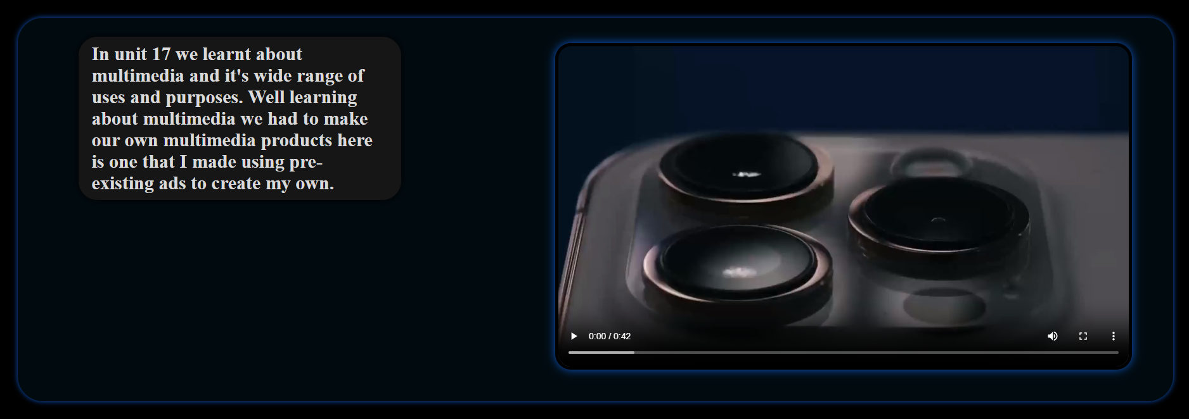
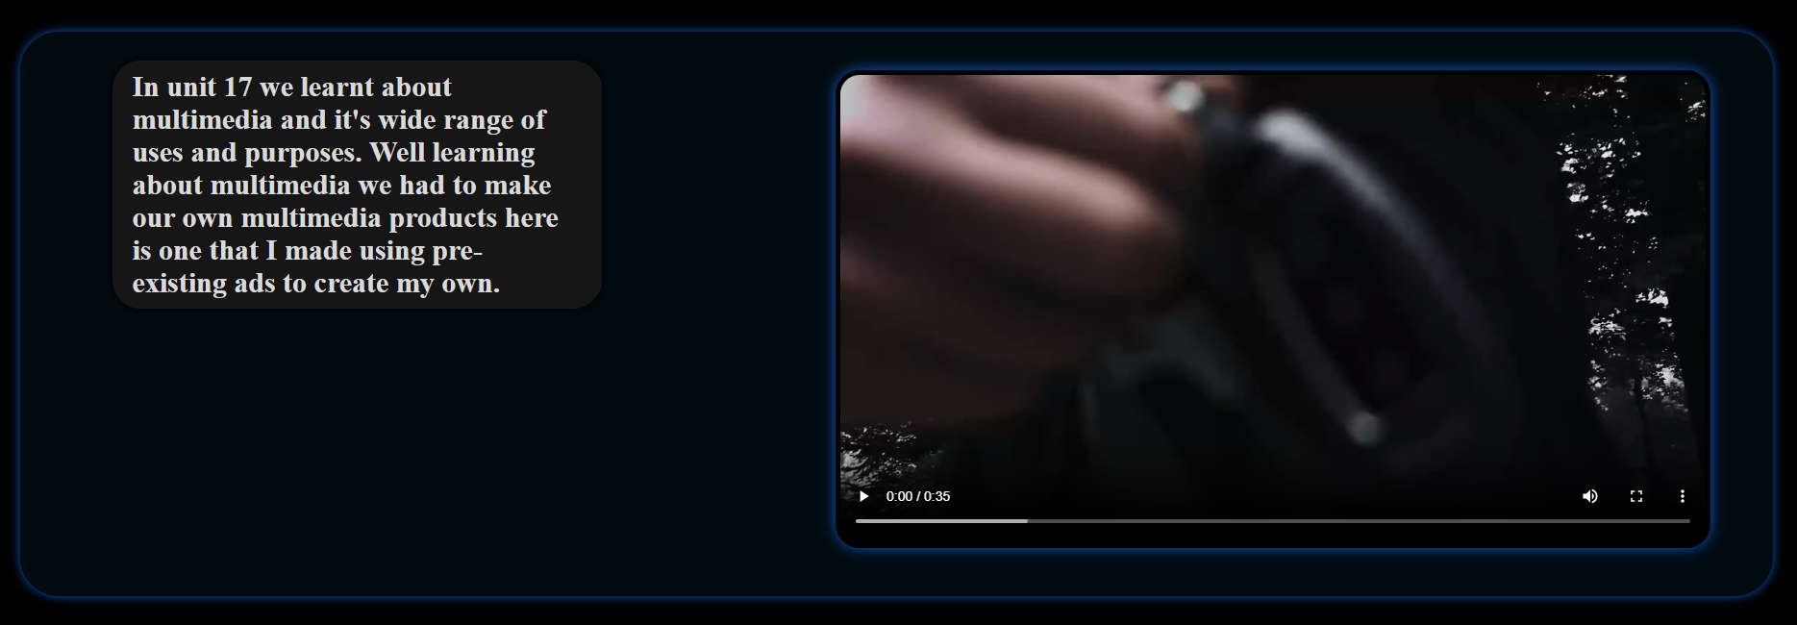
Extra content and design changes
Here's some of the content I added to the individual pages for each unit I still followed the same layout, and I added videos in where the images are for unit 17 multimedia.
I created universal boxes that I can use across all the sites, I added a nice blue glow around them to add a more futuristic look, I added a small box to put the image in text in to make a lighter background and to connect the correlation between the text box and images, so the viewer doesn't get them confused, if they're all in a long list without separation.

Slide 9
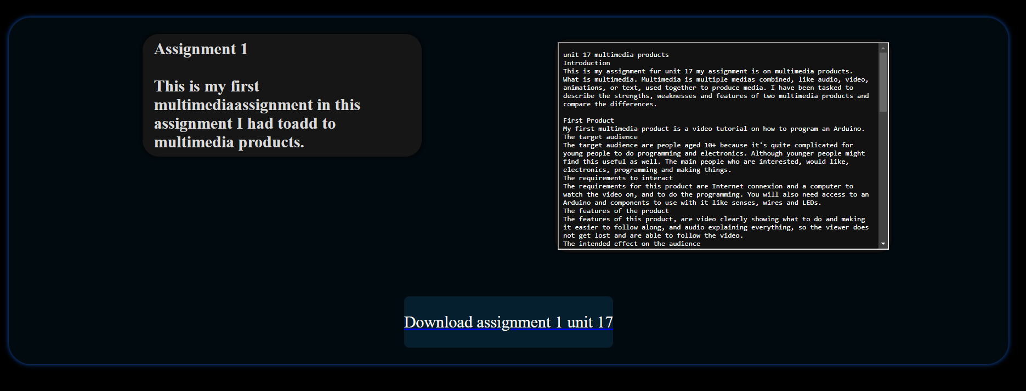
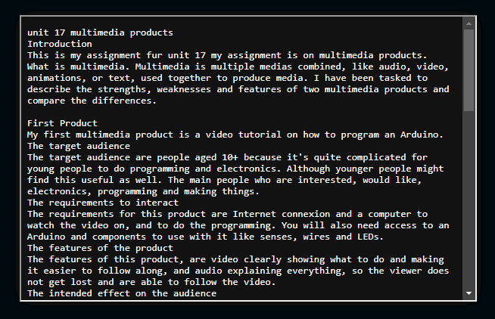
Extra content and design changes
I added text files inside some of the image boxes so the user of My Portfolio can view the work that I did on the assignments.
I also added a downloadable link so the viewer of My Portfolio can download a copy of my assignment if they want to review my work to see if my skills are of interest to them.
The textbox is a scrollable box which is linked to a text document this test document cannot display images, but I have added images inside image boxes below if necessary.

Slide 10
Test plan
Test number | Item to test | How to test | Expected outcome | Actual outcome | correct Yes or No
1 | navigation | Get other people who didn't make the site two test the navigation to see if it is self-explanatory. | I'd expect the navigation to be easy to understand considering I spent a long-time correcting is designed. | The navigation works well and is easy to understand although there are a lot of pages to go through to reach my coursework which could be an inconvenience to some people, but I do not think it's worth changing. | NO
2 | Suitability for the audiences | Check to see if all relevant content is shown and in a usable state. | Based off how I made it unexpected decided to be suitable for all the users. | The content is suitable for the audience and displays all necessary information. | No
3 | Works across multiple systems including mobile devices. | view the portfolio over multiple devices with different resolutions and on different operating systems to see if it changes the text or size of objects. | It should all navigate correctly although there could be incorrect fonts or sizes. | it worked across all different devices although the different devices display the text on the top header differently and the layout of the boxes. | Yes
4 | works across multiple browsers | check the portfolio on multiple browsers and look for problems with display images or downloading files or wrong font types | my expected outcome is that it would work successfully across all browsers although some links might not work successfully on unique browsers. | My Portfolio works the same across all browsers with no problems. | NO
5 | Do images correctly display on the page. | View all the pages and check all the images are the correct image and size. | I'll expect all images to display correctly although if you were to resize the tab, I'd expect it might mess it up. | All the images display correctly although some are the wrong size when the page is resized, although I wouldn't expect people to resize it. | NO
6 | do all hyperlinks and downloadable files work. | check all the hyperlinks to see if they like successfully too linked pages and check all the downloadable files to see if they successfully download. | Assuming I set it up correctly I'd expect all the hyperlinks to work although I wouldn't be surprised if there are some problems with the downloads. | Not all the hyperlinks work, and I have had problems with the downloads I need to add a link for each individual file | Yes

Slide 11
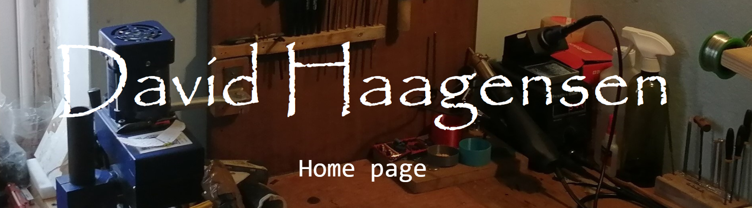
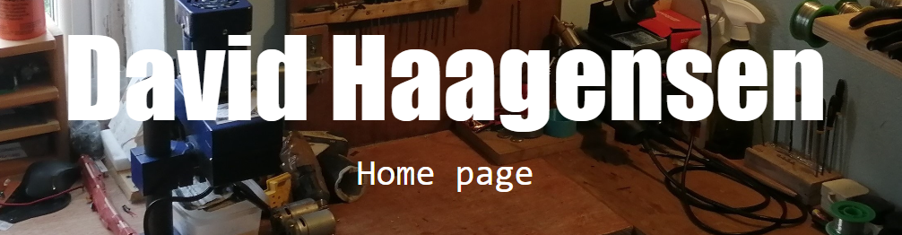
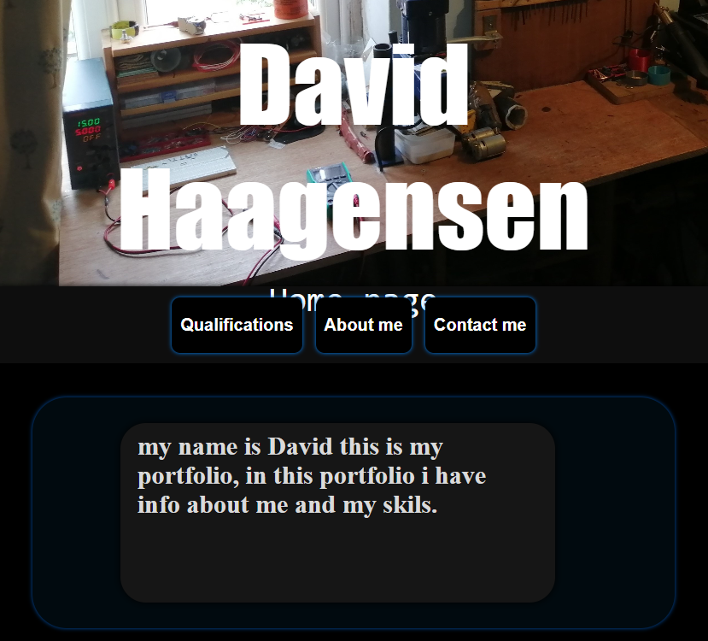
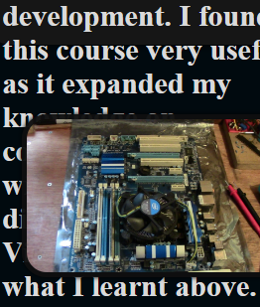
Testing I have multiple devices
I corrected the font type on the top header because it didn't work across multiple devices, on one computer it will display a thick large font which is what I was aiming for and on another one it would display a papyrus like font.
It was a simple fix to change the font type to a universal one that is the same across multiple devices.
fixing layout issues across devices
In different operating systems and devices, it showing text going out-of-the-box it is confined by and being hidden by images.
I had to change the constraints of the boxes to the size of whatever the text is so it would solve this problem.

Slide 12
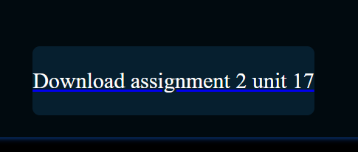
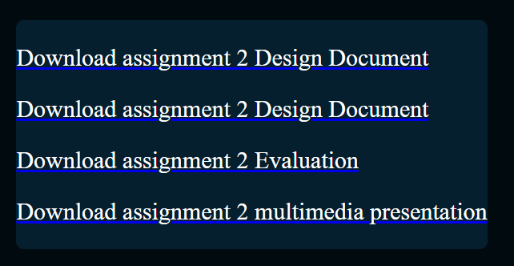
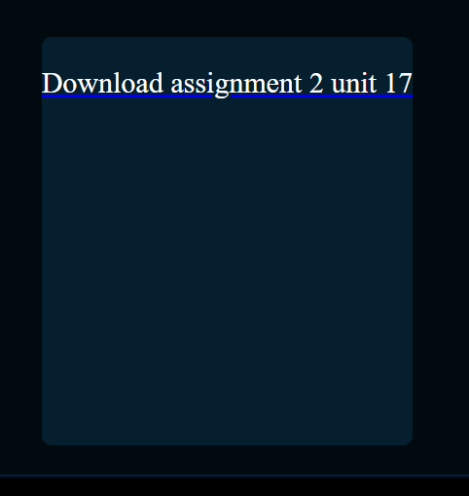
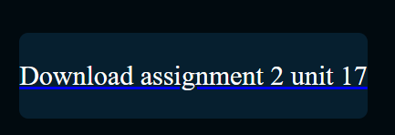
Fixing hyperlinks and downloads
I added multiple download links for each individual file rather than just having this one because otherwise it wasn't downloading all of them.
Fixing box size and shape
When I had the page sized in a certain way it displayed the box much higher than it should be, so I had to change the height to the correct amount.

Slide 13
feedback questionnaire
Please answer all the following questions about My Portfolio honestly.
Is My Portfolio easy to navigate?
Are the color choices good and relevant?
Does it display all the necessary information for employers?
Does it work on your devices and are there any bugs?
Are there any design changes that you would recommend?
It's all the text easy to read and understand?
link to portfolio

Slide 14
feedback questionnaire results 1
Is My Portfolio easy to navigate?
Yes, I had no trouble navigating the site
Are the color choices good and relevant?
The colour choices were predominantly black and white with some blue outlines. The simple style helped focus on the information. The workshop photos looked great.
Does it display all the necessary information for employers?
Employers may want more information on different parts of the course as some units had no details. They may also want information about other activities you do and some kind of personal statement about what work/ career path you are looking for.
It would have been nice to have a page about the workshop featured and what you have made in it. Does it work on your devices and are there any bugs?
It worked on my phone and laptop.
Are there any design changes that you would recommend?
Many of the subtitles for units in the level 2 course seemed too small for me to notice easily but the one for unit 17 was great.
Is all the text easy to read and understand?
Most of the text is easy to read and understand but there are a few grammer, punctuation and typing errors it would be good to fix.

Slide 15
feedback questionnaire results 2
Please answer all the following questions about My Portfolio honestly.
Is My Portfolio easy to navigate?
Yes, the website is easy to navigate although it is quite a process to get back to the home page from the courses because there is not a direct link if this could be added that would be great.
Are the color choices good and relevant?
I found all the color choices were great although it could be considered as being a bit dark but I think this works well.
Does it display all the necessary information for employers?
Yes, I think it does display at least most of the information that employers would require although more detail on what you learned on the courses would be very useful for them.
Does it work on your devices and are there any bugs?
The site works perfectly on my device and there were no problems with displaying anything on my screen.
Are there any design changes that you would recommend?
I would recommend to add more relevant information about what you learned in the course and adding a more direct means to get to the home page so a universal button home would be useful.
Is all the text easy to read and understand?
All the text was easy to read and understand and I found it all very professional looking.

Slide 16
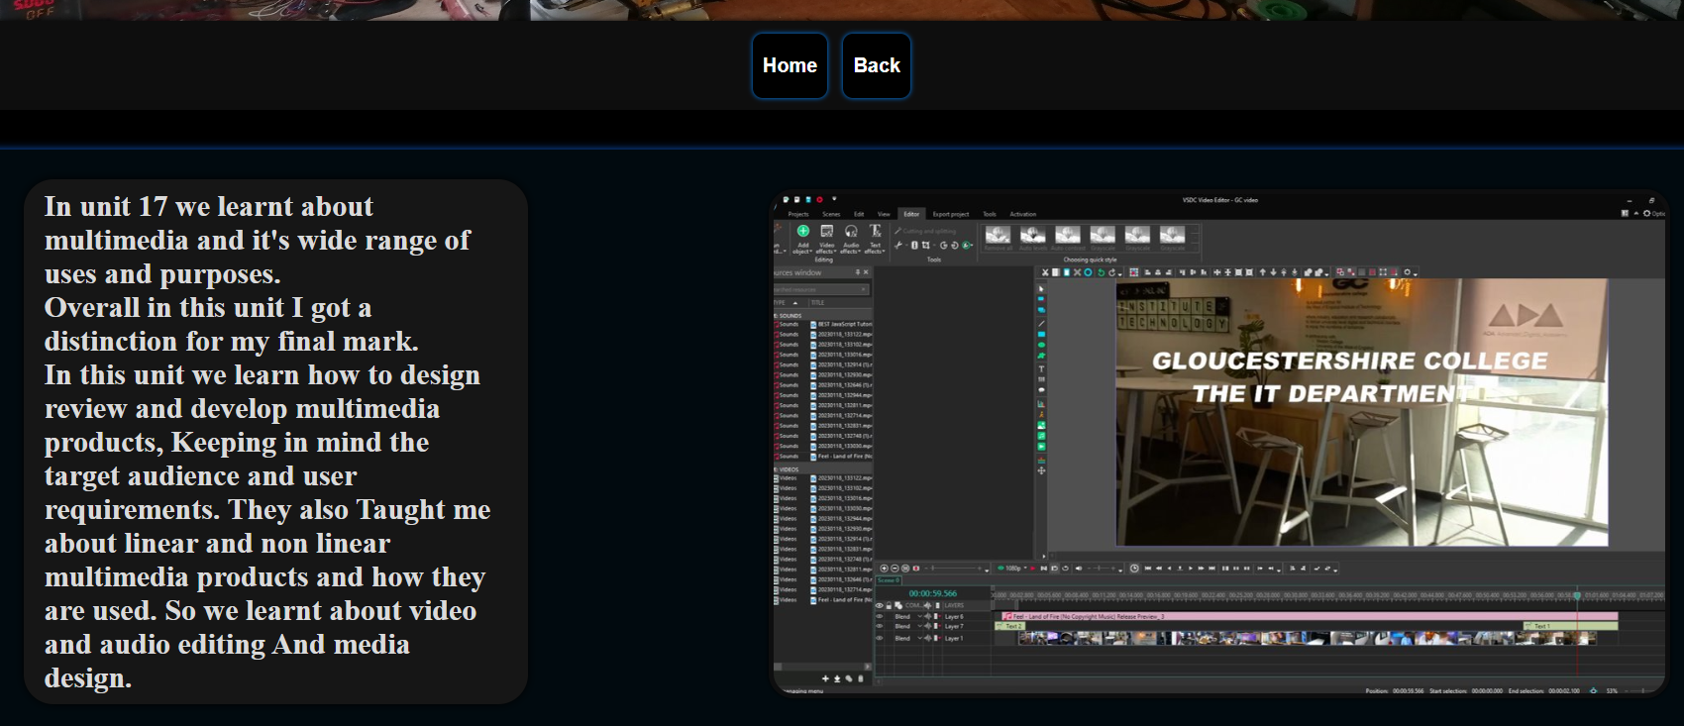
User feedback changes
Based off the user feedback I added an extra button so I can link directly home from each of the units page making navigation faster and easier.
I talked more about what I learned on each unit two better display my skills to the audience.
I also changed some of the displayed images or videos to more relevant content to what I was taught in the unit.

Slide 17
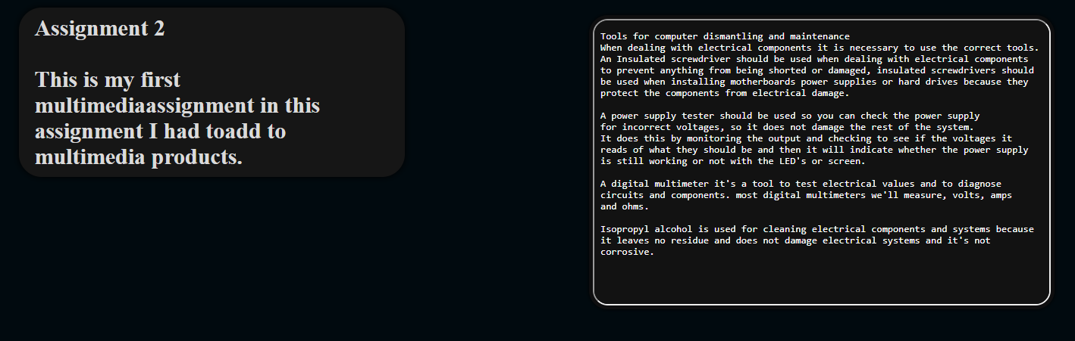
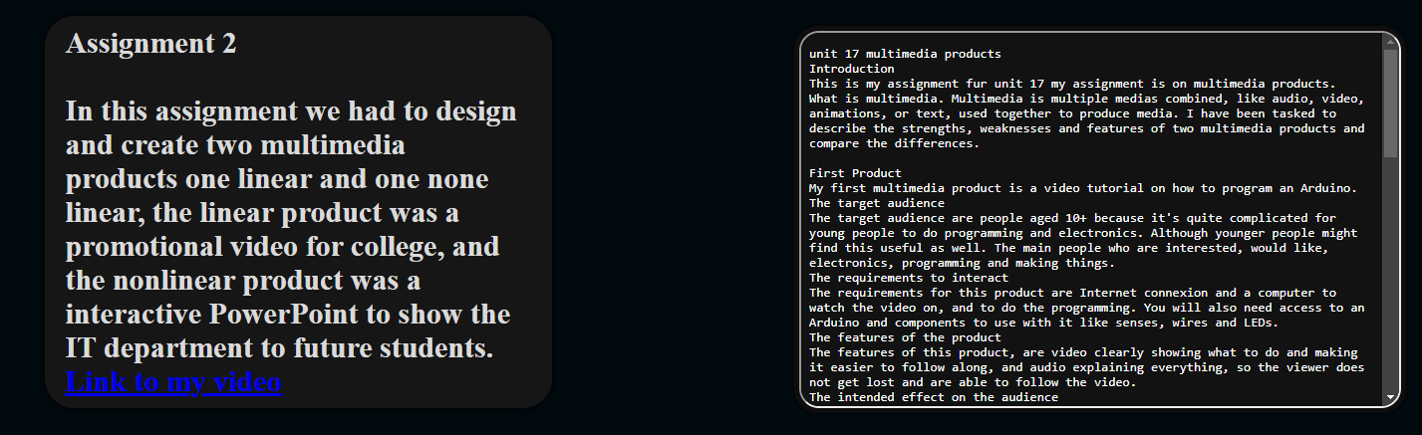
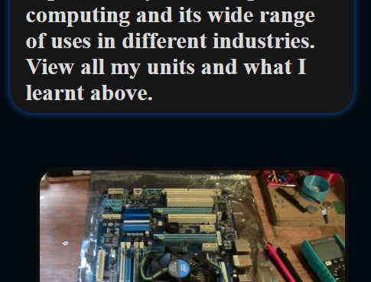
User feedback changes
based off my feedback and my own use of the site I have decided two add more information on all my unit pages, so I have added an extra paragraph to describe what I have land in each unit.
Based off my use of the site I found on some devices or if I rescale the page it would display things like textboxes in the wrong size said the text would spell out-of-the-box,
fix this I change the parameter that sets the height of the box to 100% this says beatboxes height to 100% of the text fixing the problem.

Slide 18
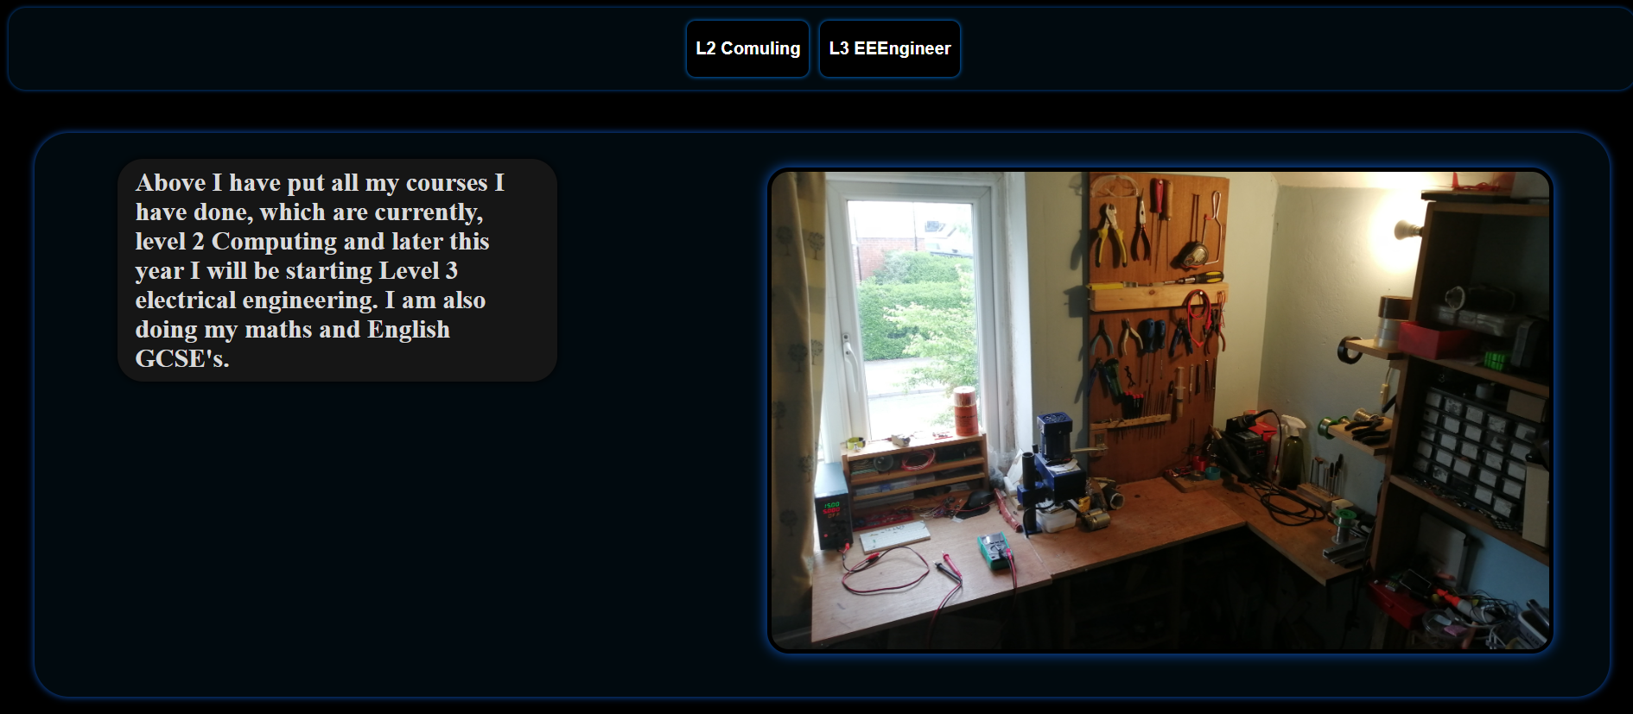
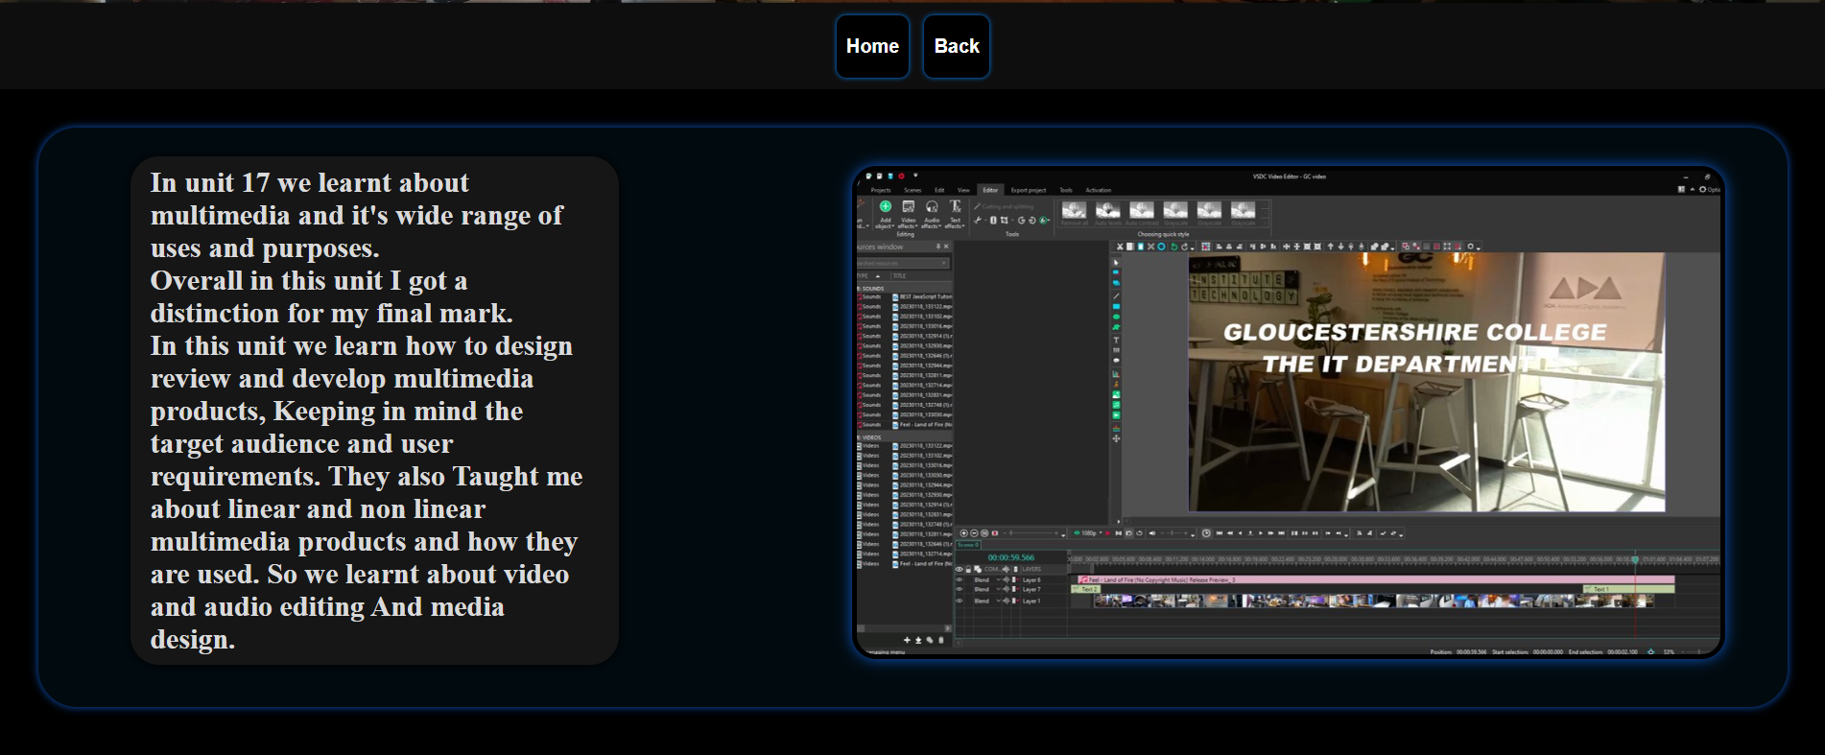
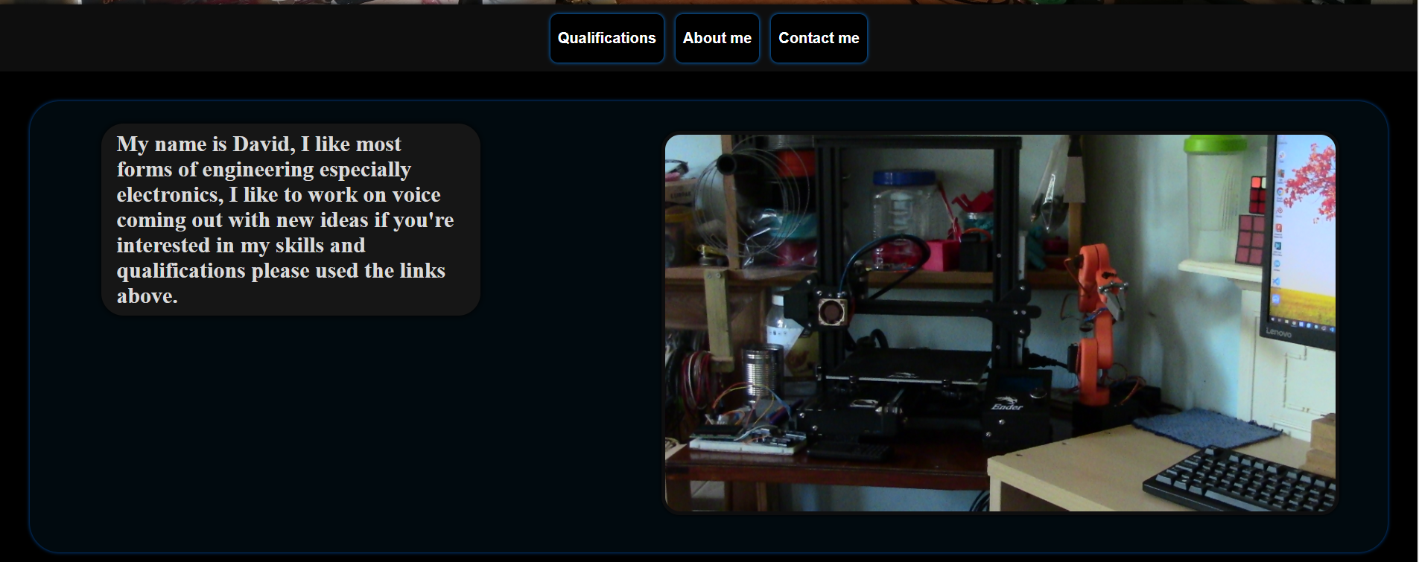
How my portfolio meets the needs of the audience
My Portfolio meets the needs of the audience and its requirements by showing all the work I have done and what I learned in my different courses.
it's also got very logical navigation which is easy to use making it much easier to navigate throughout the site.
I have used relevant assets and content like images of my work and text for the course work, which will help to display my skill set to the audience future employees or apprenticeships making the portfolio suitable for advertising my skills which is its main purpose.
Based off some of my feedback I could probably improve the quality of the some of the content on my portfolio and add more information about what I learned.

Slide 19
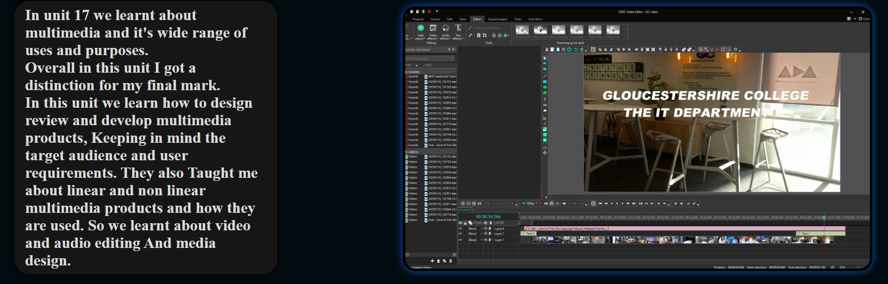
Results of your testing and the user feedback
Due to my testing, I was able to find some issues with how the site displayed some of the text and boxes, but I was able to fix this by adjusting some of the parameters that set the size.
based off my user feedback I gathered that I need to display more relevant content on each page, so I added more about each unit and about me, so it does a better job of informing my audience.

Slide 20
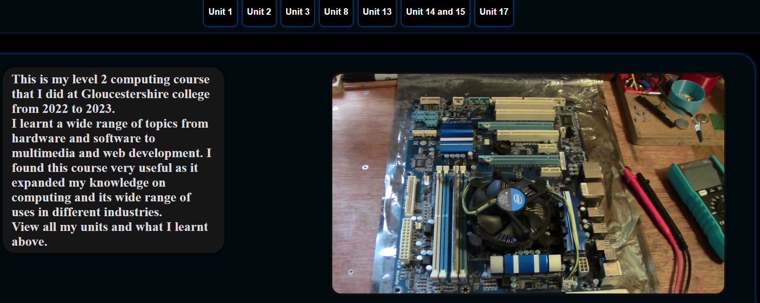
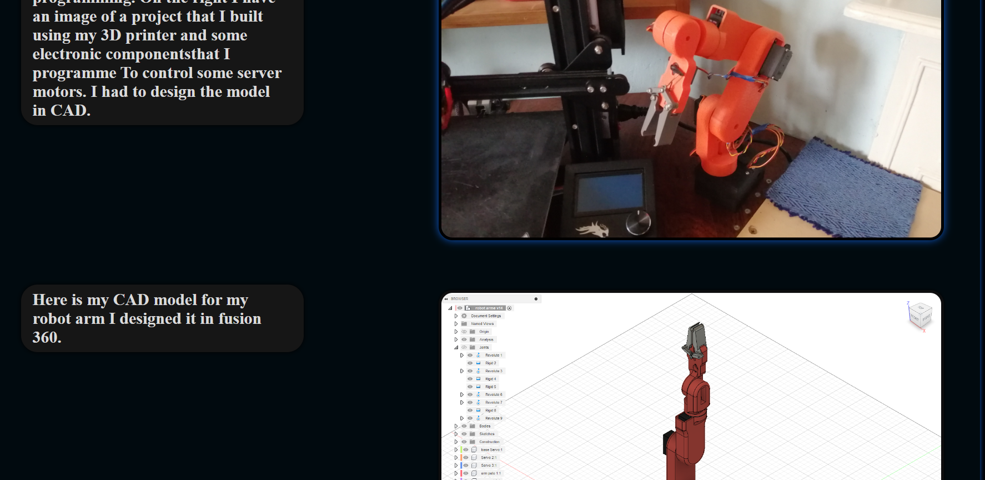
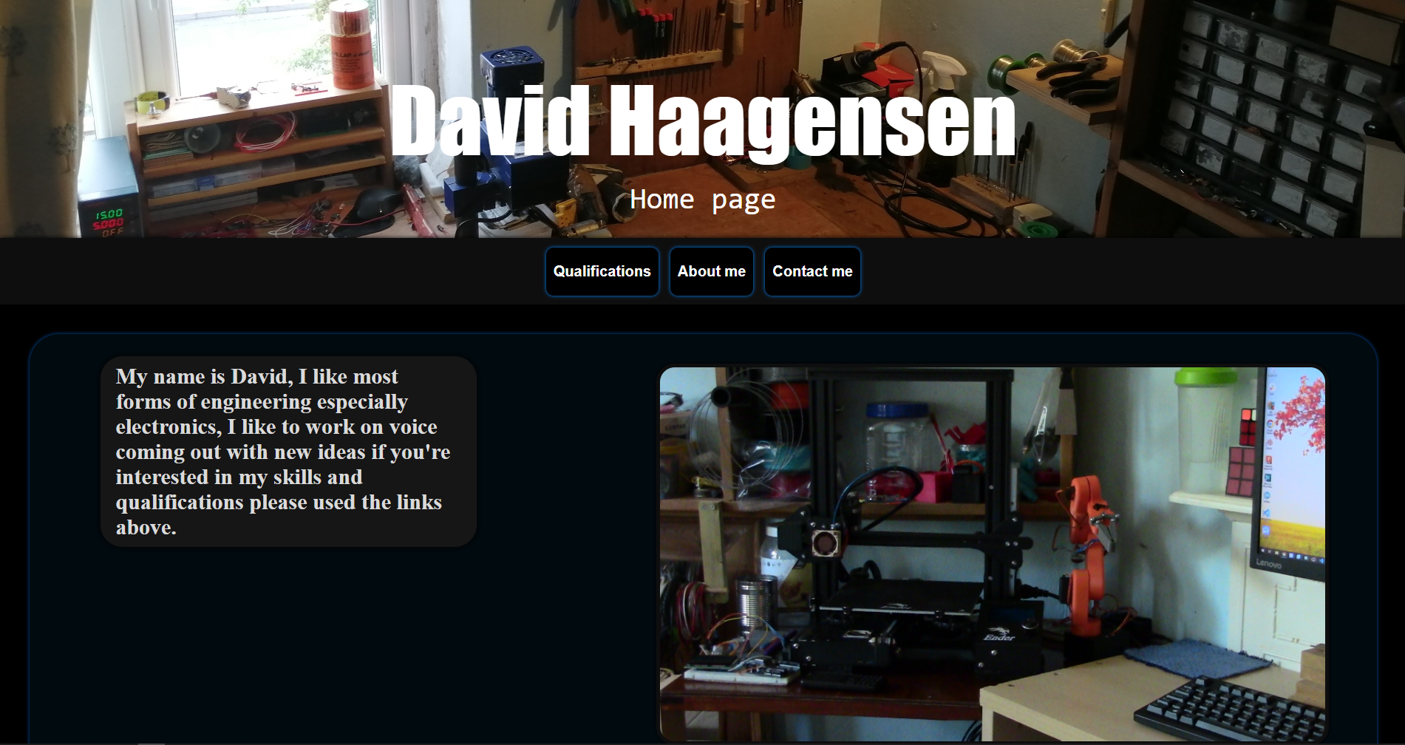
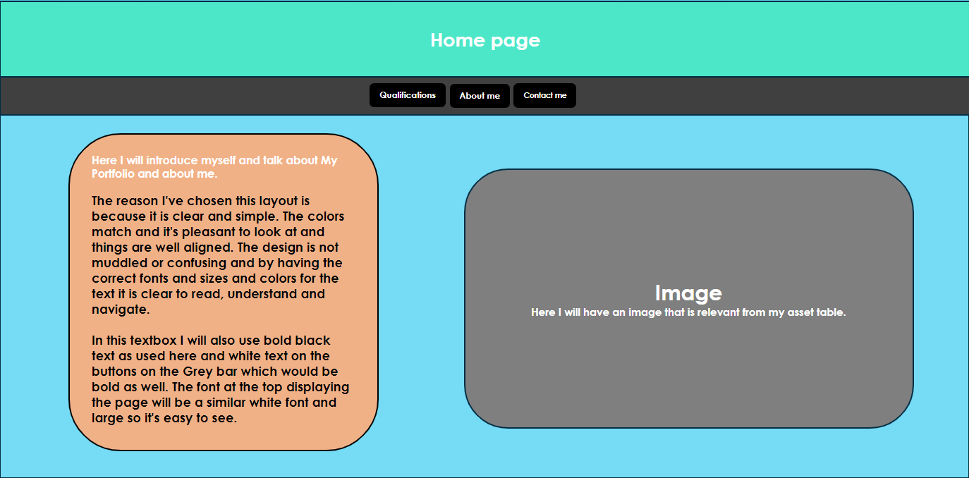

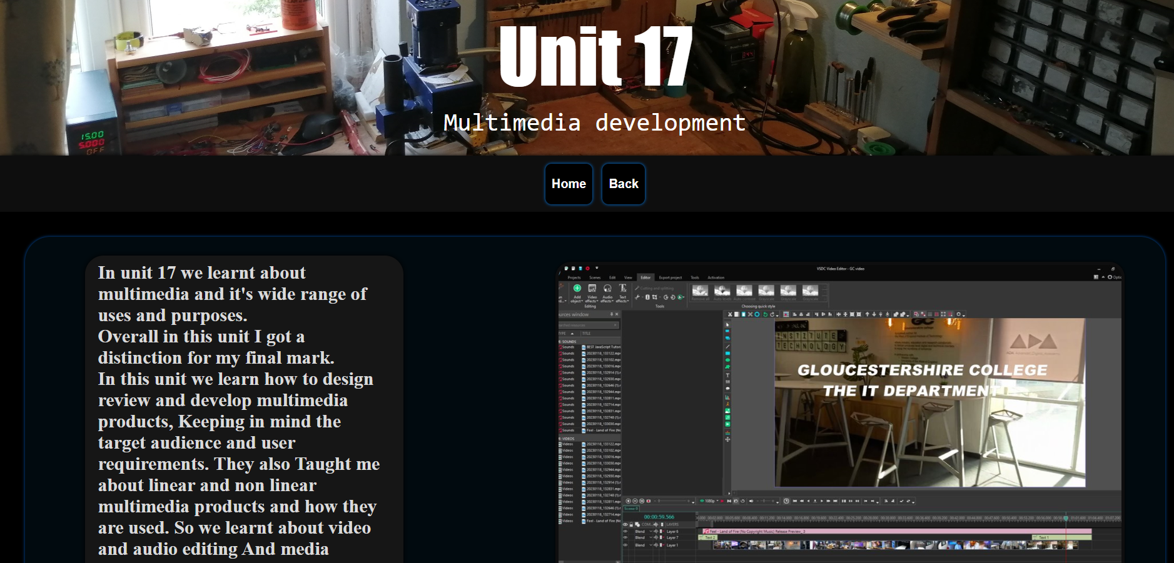
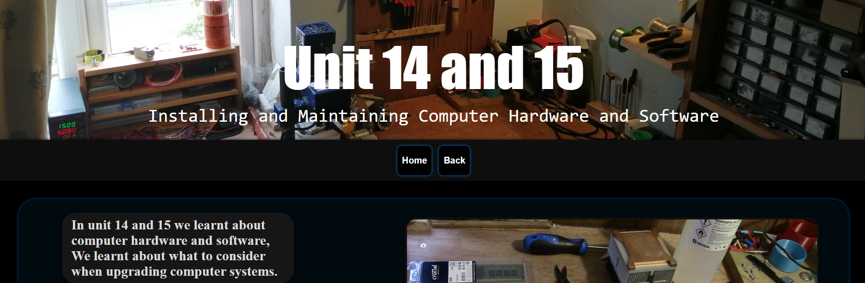

Evaluation and comparison of original plans and finished product
Suitability for the intended audience and purpose
I think that I've made it suitable for the intended purpose by adding all my necessary information including contact details and my skills as well as all the work that I have done throughout my course.
This is all information that employers wi'll need, I have also displayed the content in a more professional way which helps catch the intended audience.
Justification of design changes
I chose to have quite a dark color scheme for My Portfolio because white and bright colors can be quite glaring and can look quite unprofessional and a lot of modern websites and portfolios seemed to be going down the route of a darker grayer background so I thought I would use the same idea. My original designs of course are quite bright and vibrant color's which although look quite cool didn't match bye content and wouldn't look professional considering my audience.
my original designs had all the units on one page, but this would have issues because it would be far too cluttered for the users to view my coursework, so I added a separate page for each unit and this makes it much less cluttered although means there are more pages to navigate through to access the information, but I think this is a reasonable trade off.
Some future improvements that I could make would be too sure more work that I did and what I learned as well as interface or windows to show projects I've worked on maybe on the about me page.
I could also add dropdowns to the buttons displaying my course to each unit for faster navigation and descriptions below each button so they users can access relevant information faster.

